Slide 1

Data Presentation
Peleg Abraham-Oz

Slide 2
General information
Subjects total: 65
Two environment: Classroom & Café
Subject data : 60
Subject that not included: 40 (one session), 47 (outlier, but included), 60 (same part twice), 26 (one session)

Slide 3
Environments
Café vs Classroom

Slide 4
Classroom

Slide 5
Classroom-Accuracy

Slide 6
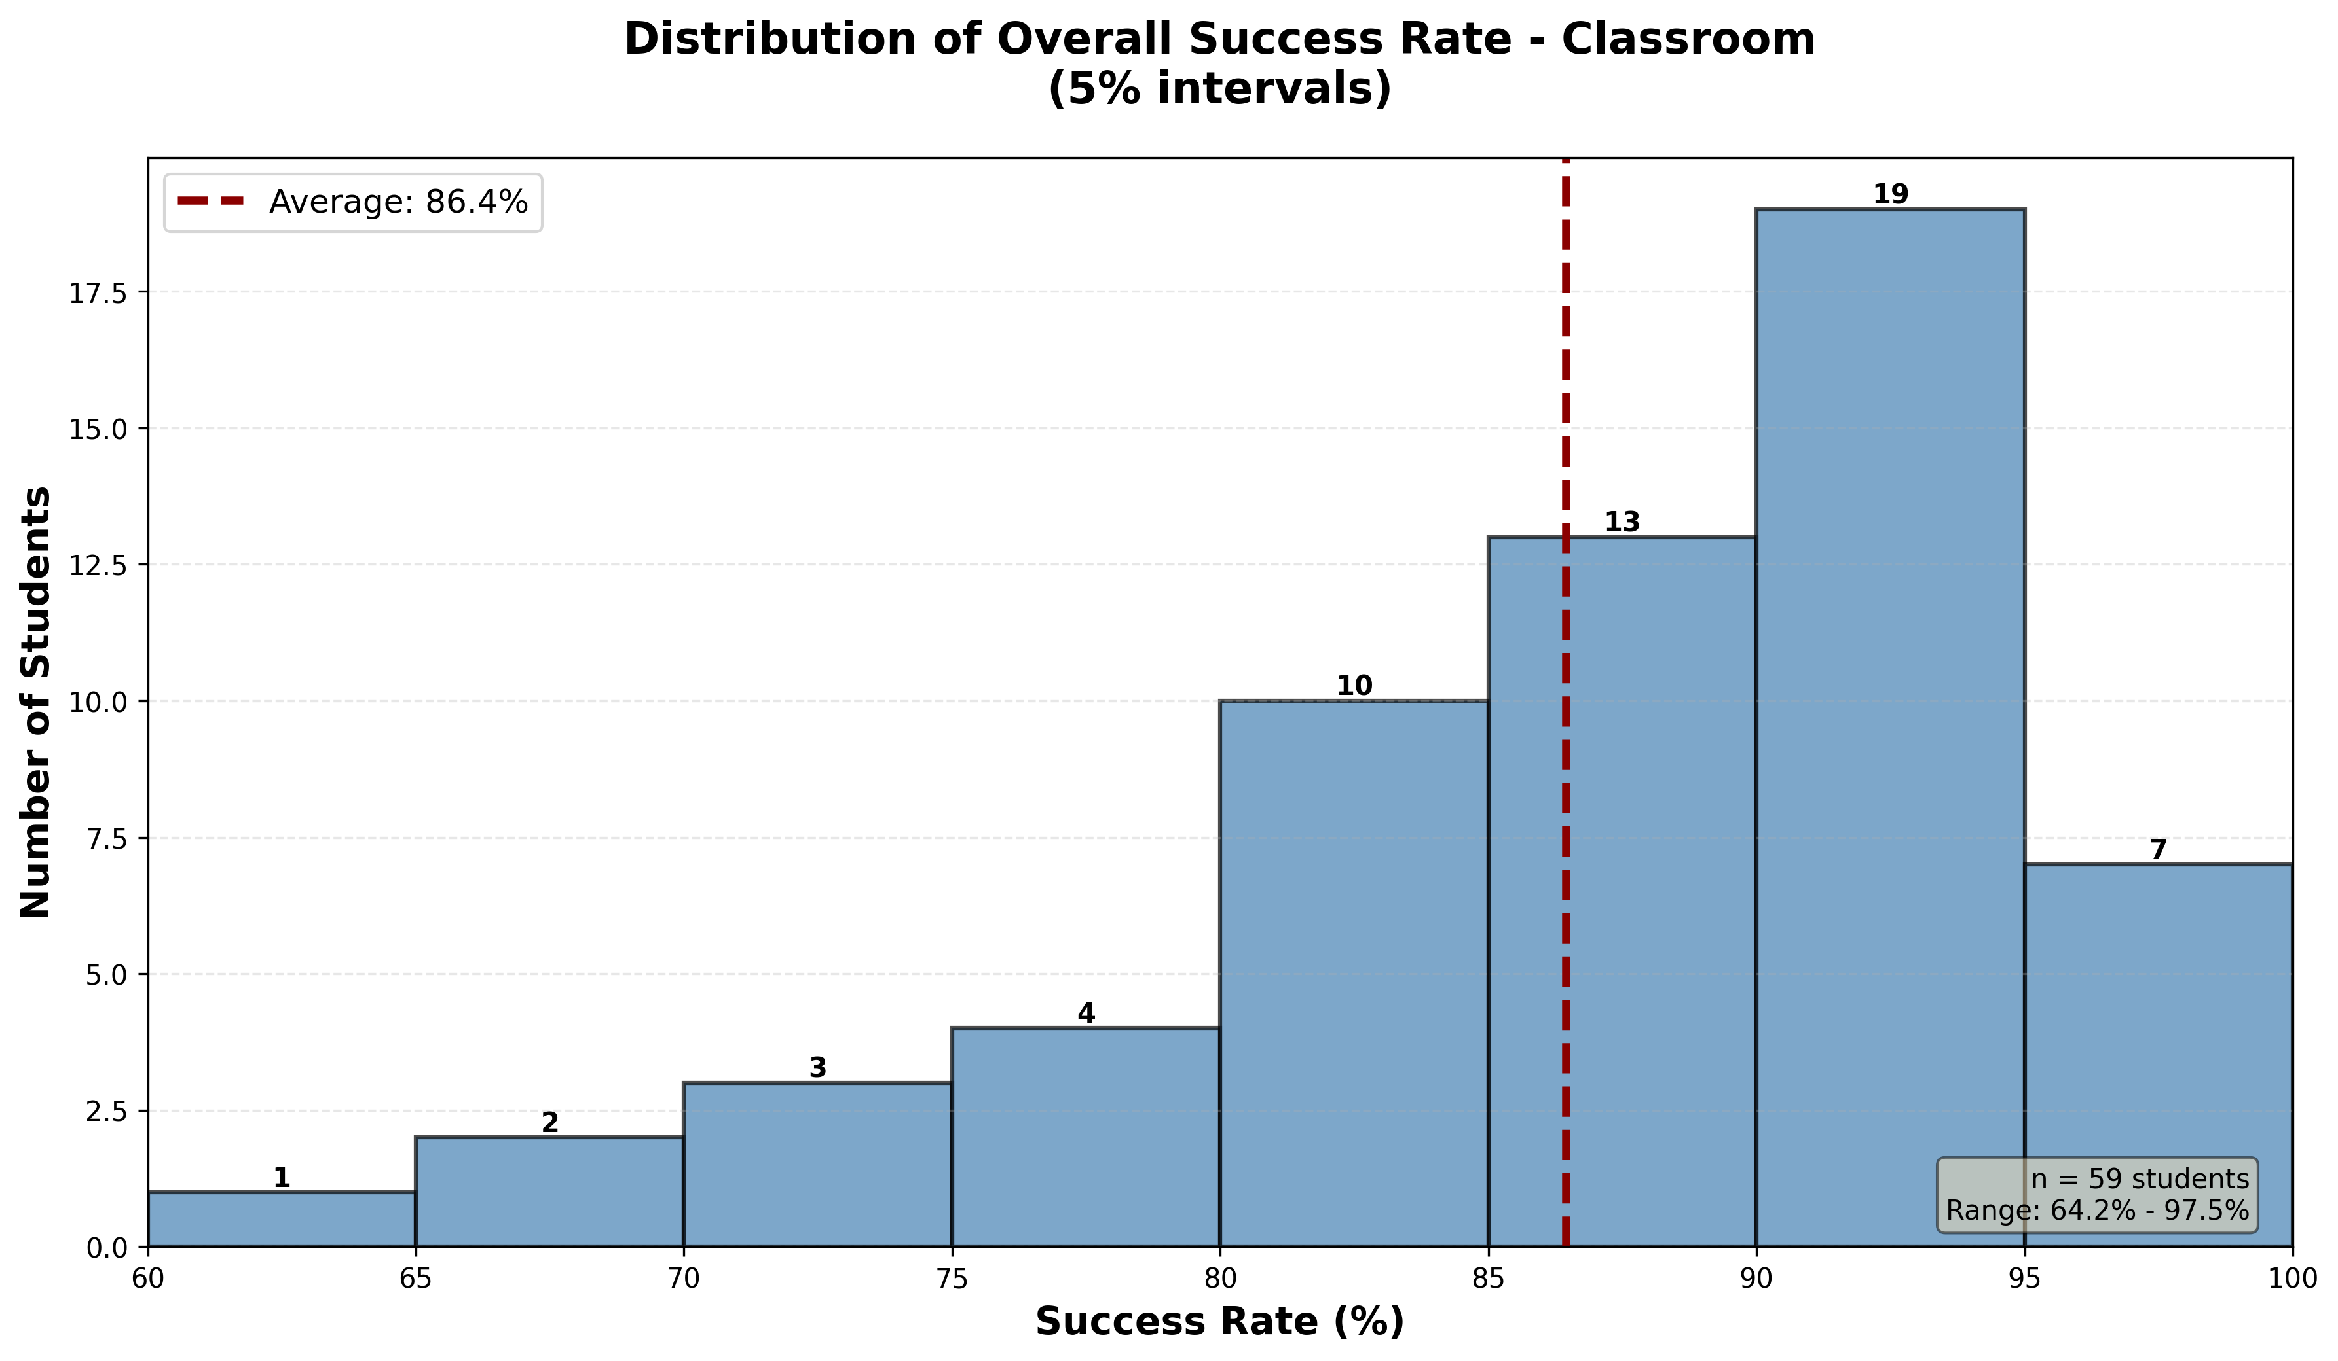


Slide 7
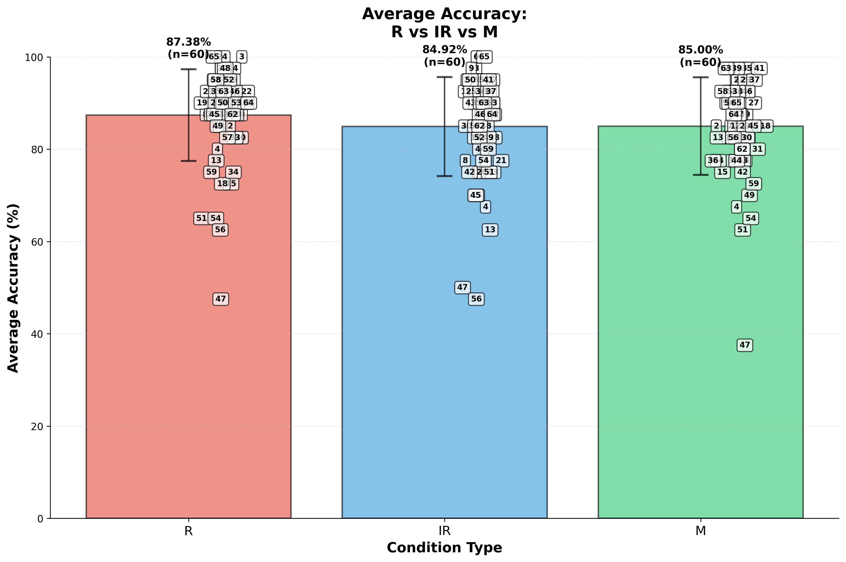

Slide 8
Anova- one way
Source of Variation | SS | df | F | P-value | F crit
Between Groups | 233.8194 | 2 | 1.076086 | 0.343147 | 3.047012
Within Groups | 19229.9 | 177

Slide 9
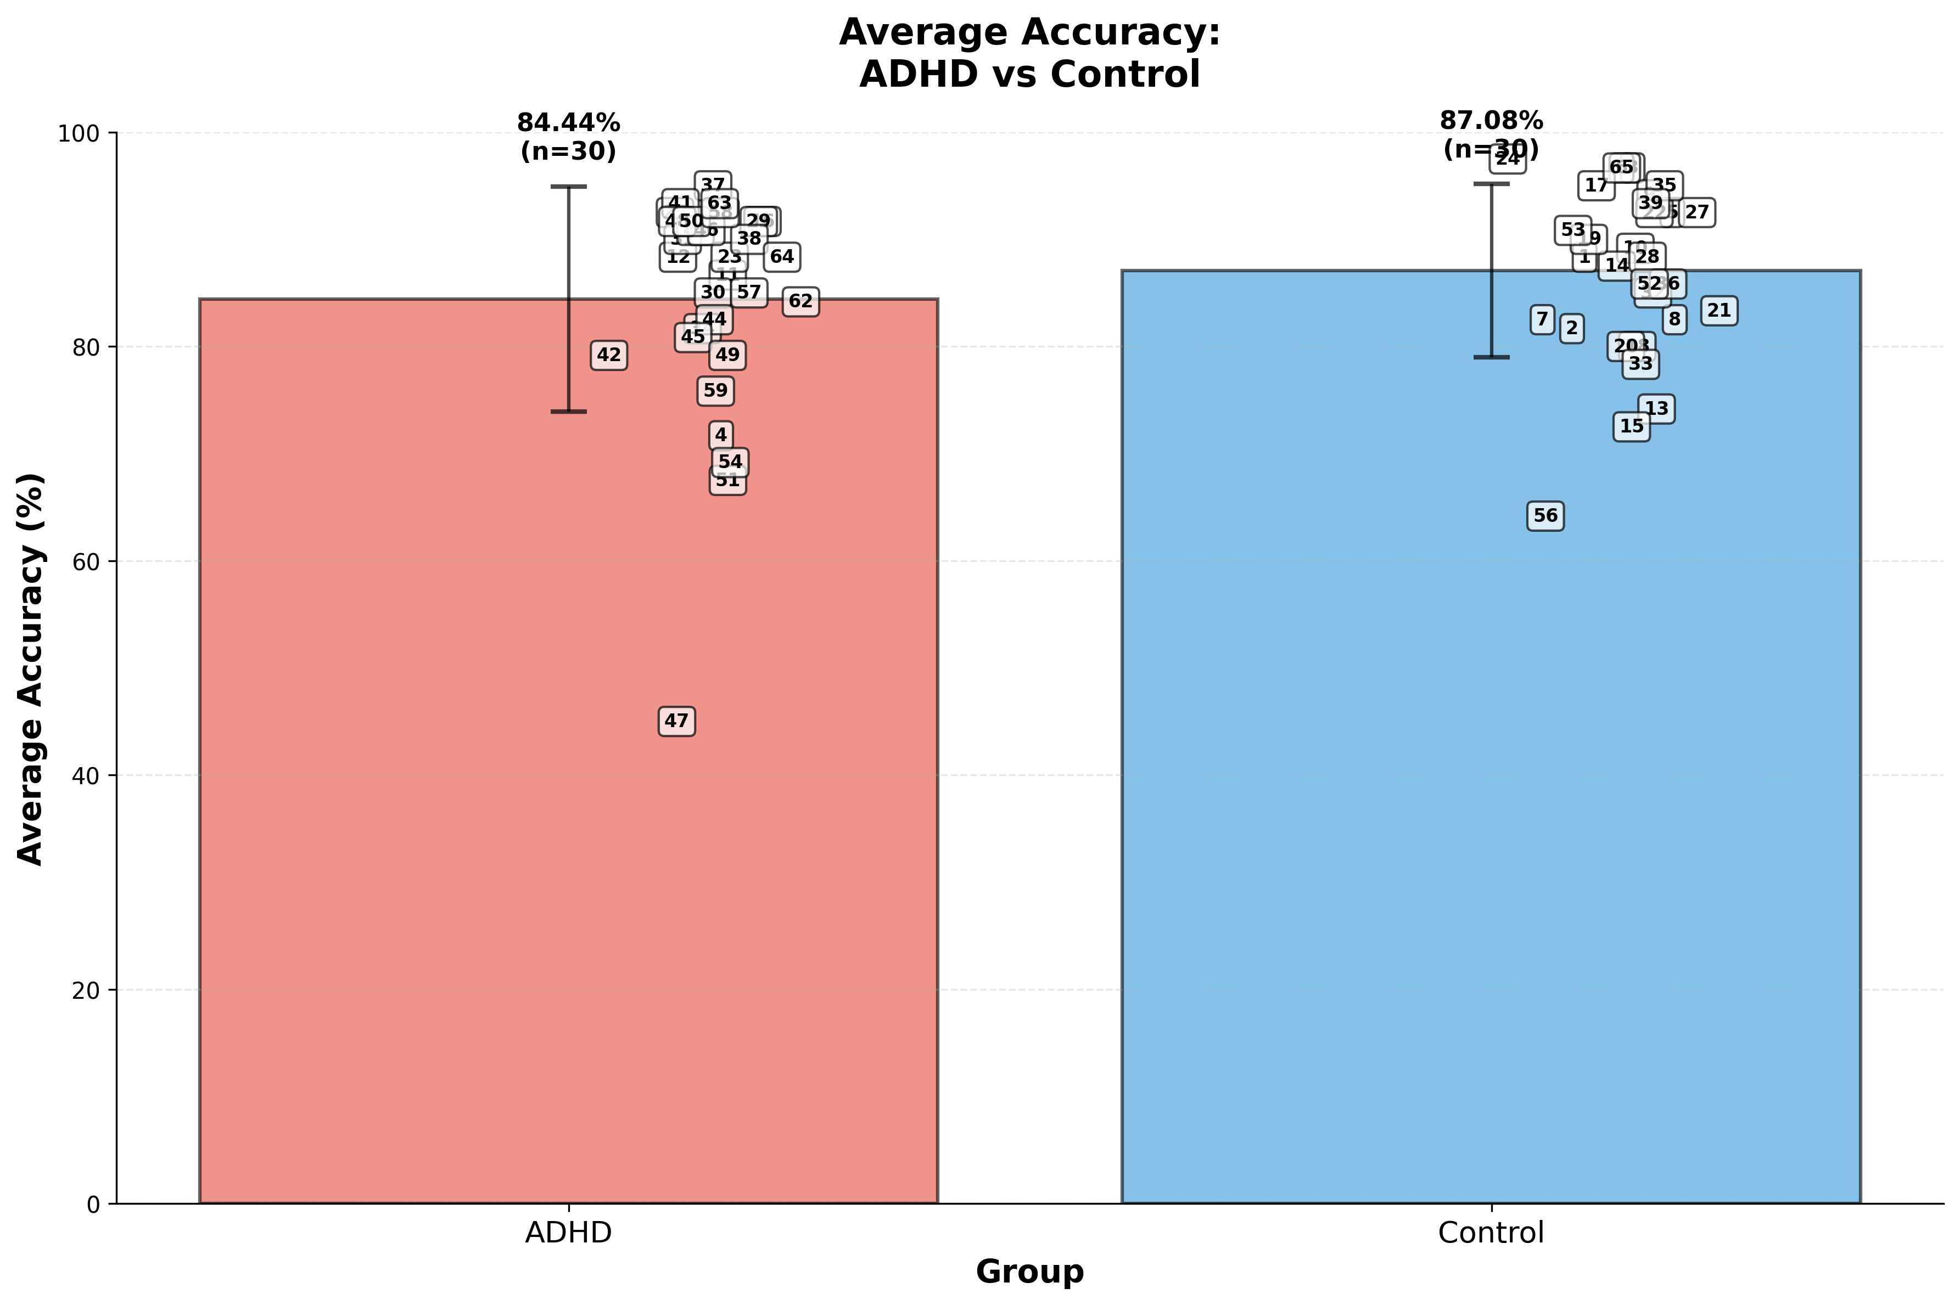

Slide 10
T-test independent- ADHD , Control
T-test results
t-statistic | -1.0912
p-value | 0.279
Degrees of Freedom (df) | 58
Effect size(Cohen's d)
Cohen's d Value | -0.281

Slide 11
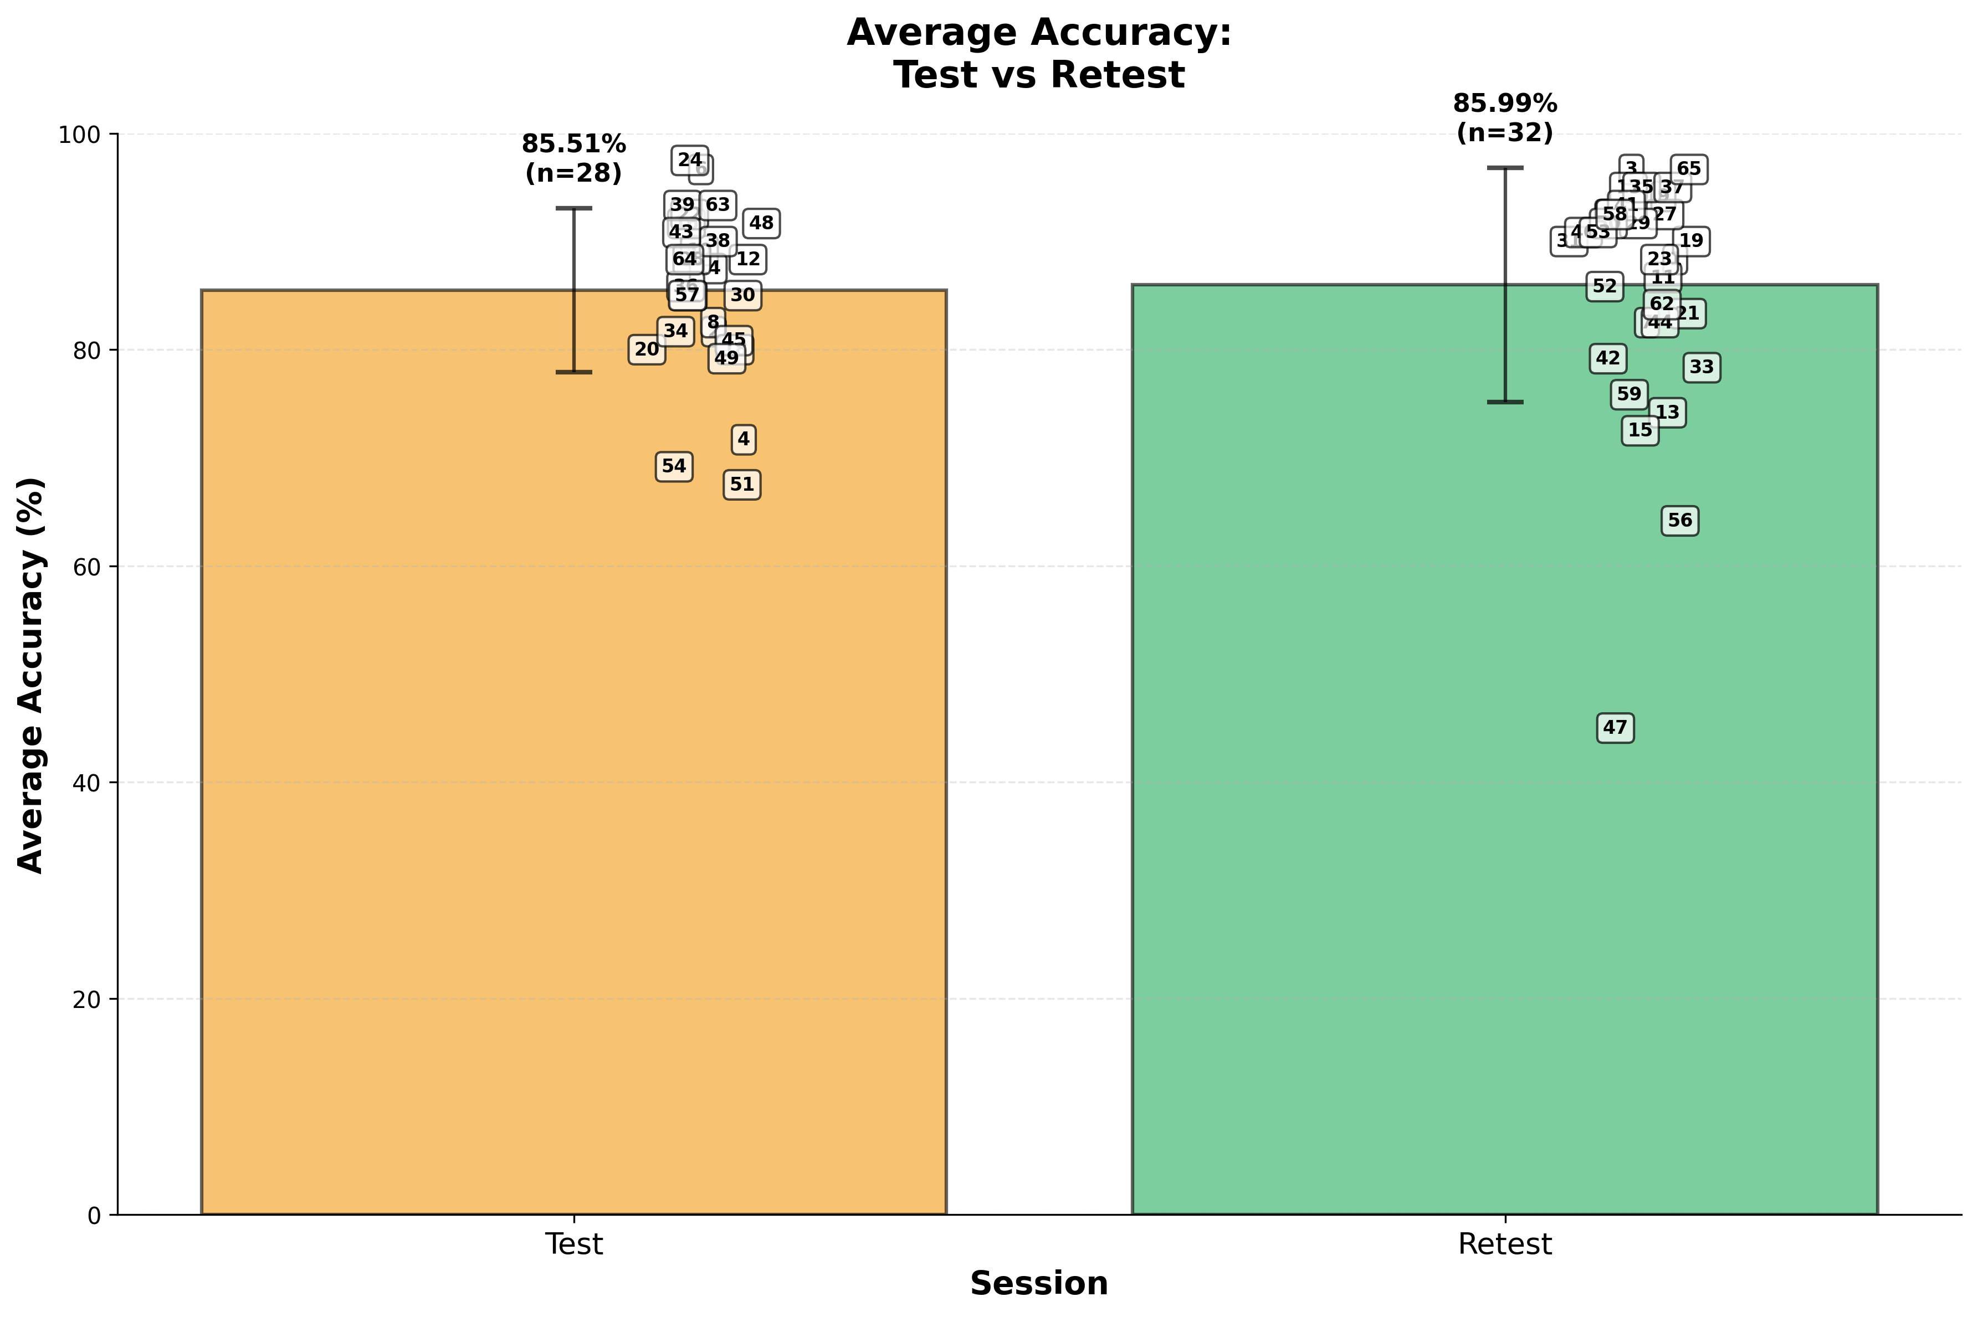

Slide 12
Classroom-Interest level

Slide 13
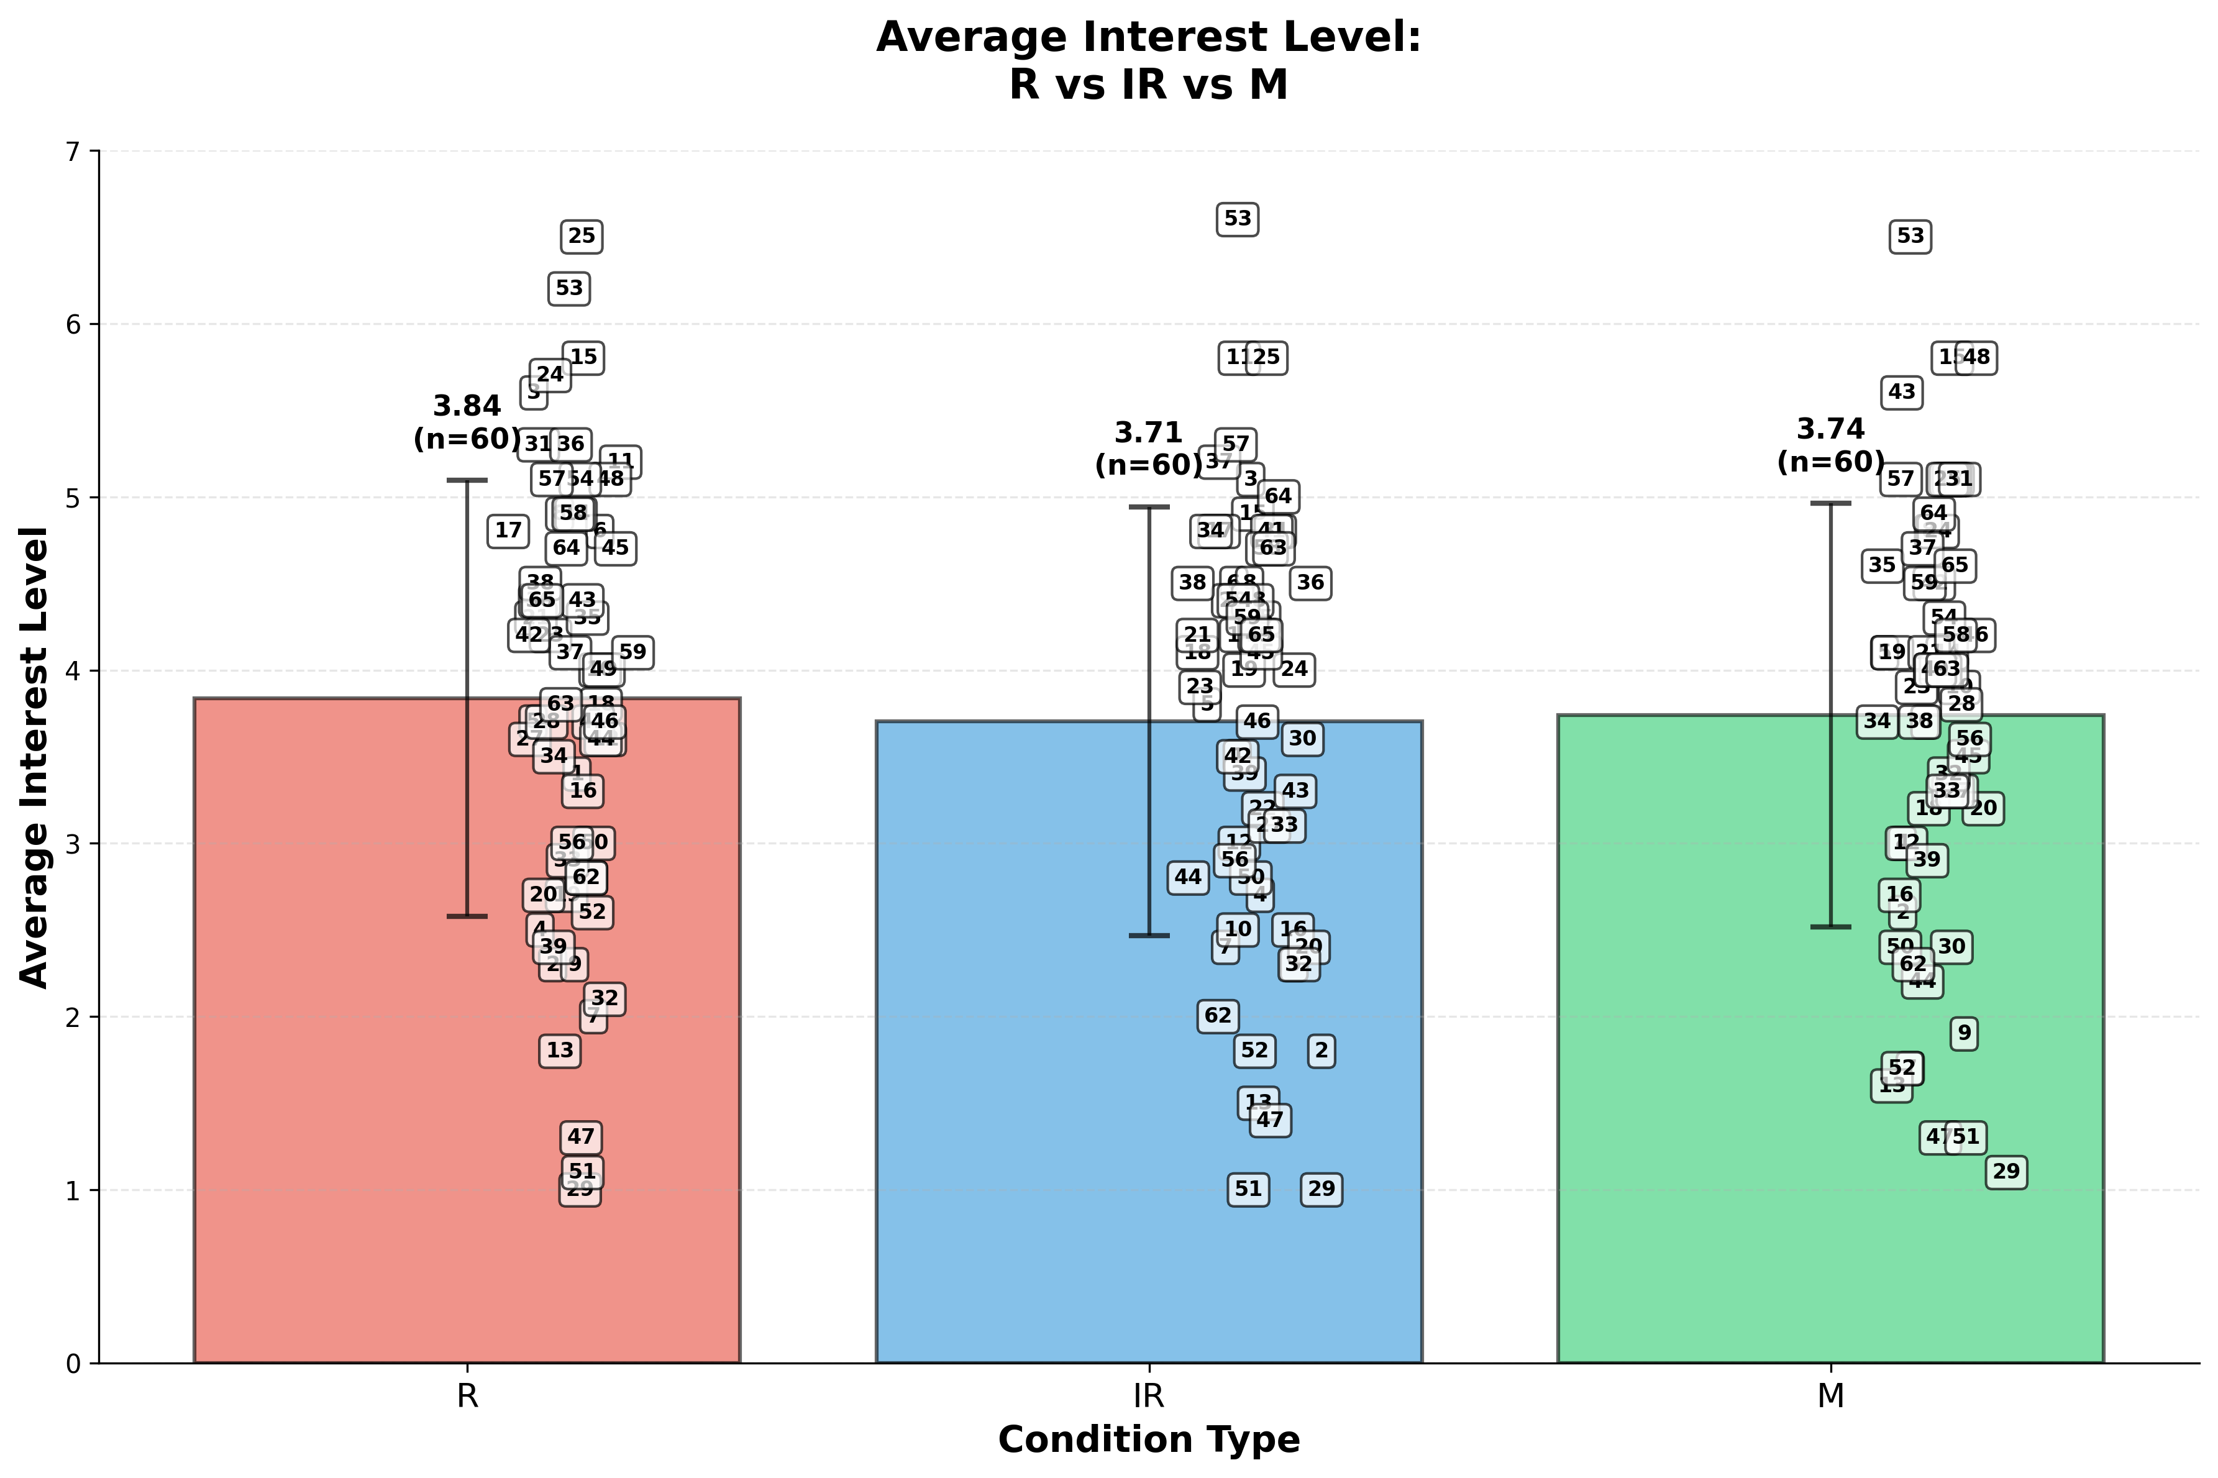

Slide 14
Anova- one way
Source of Variation | SS | df | F | P-value | F crit
Between Groups | 0.558111 | 2 | 0.18155 | 0.83412 | 3.04701
Within Groups | 272.05183 | 177

Slide 15
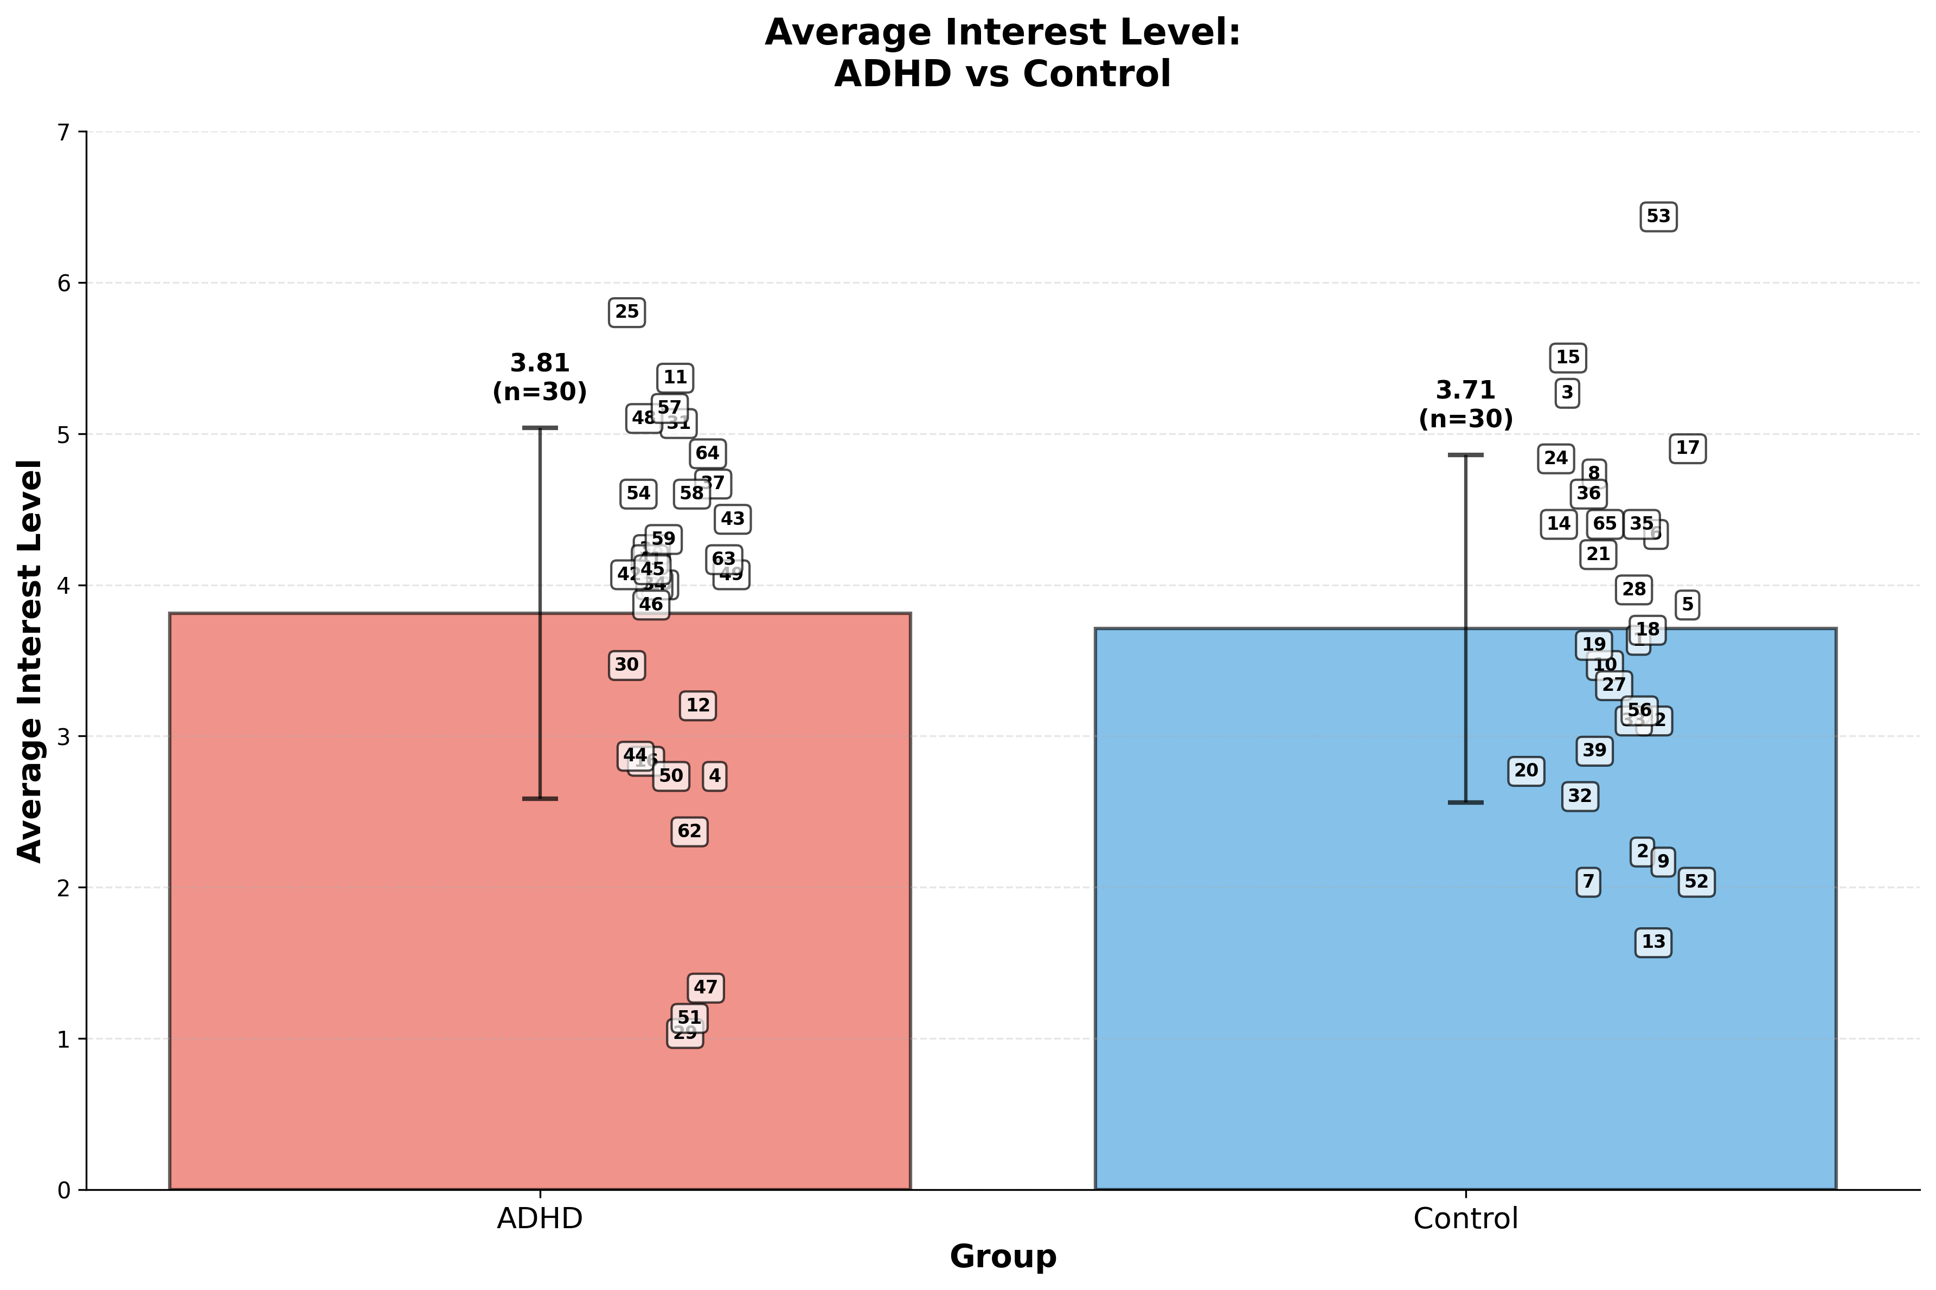

Slide 16
T-test independent- ADHD , Control
T-test results
t-statistic | 0.3295
p-value | 0.7429
Degrees of Freedom (df) | 58
Effect size(Cohen's d)
Cohen's d Value | 0.0851

Slide 17
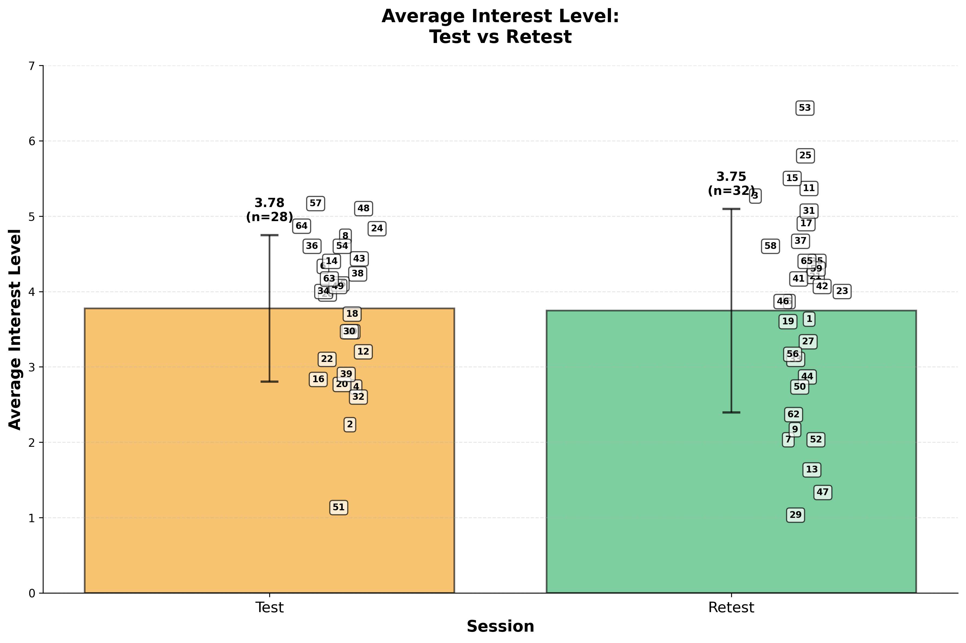

Slide 18
Cafe

Slide 19
Café
-Accuracy

Slide 20
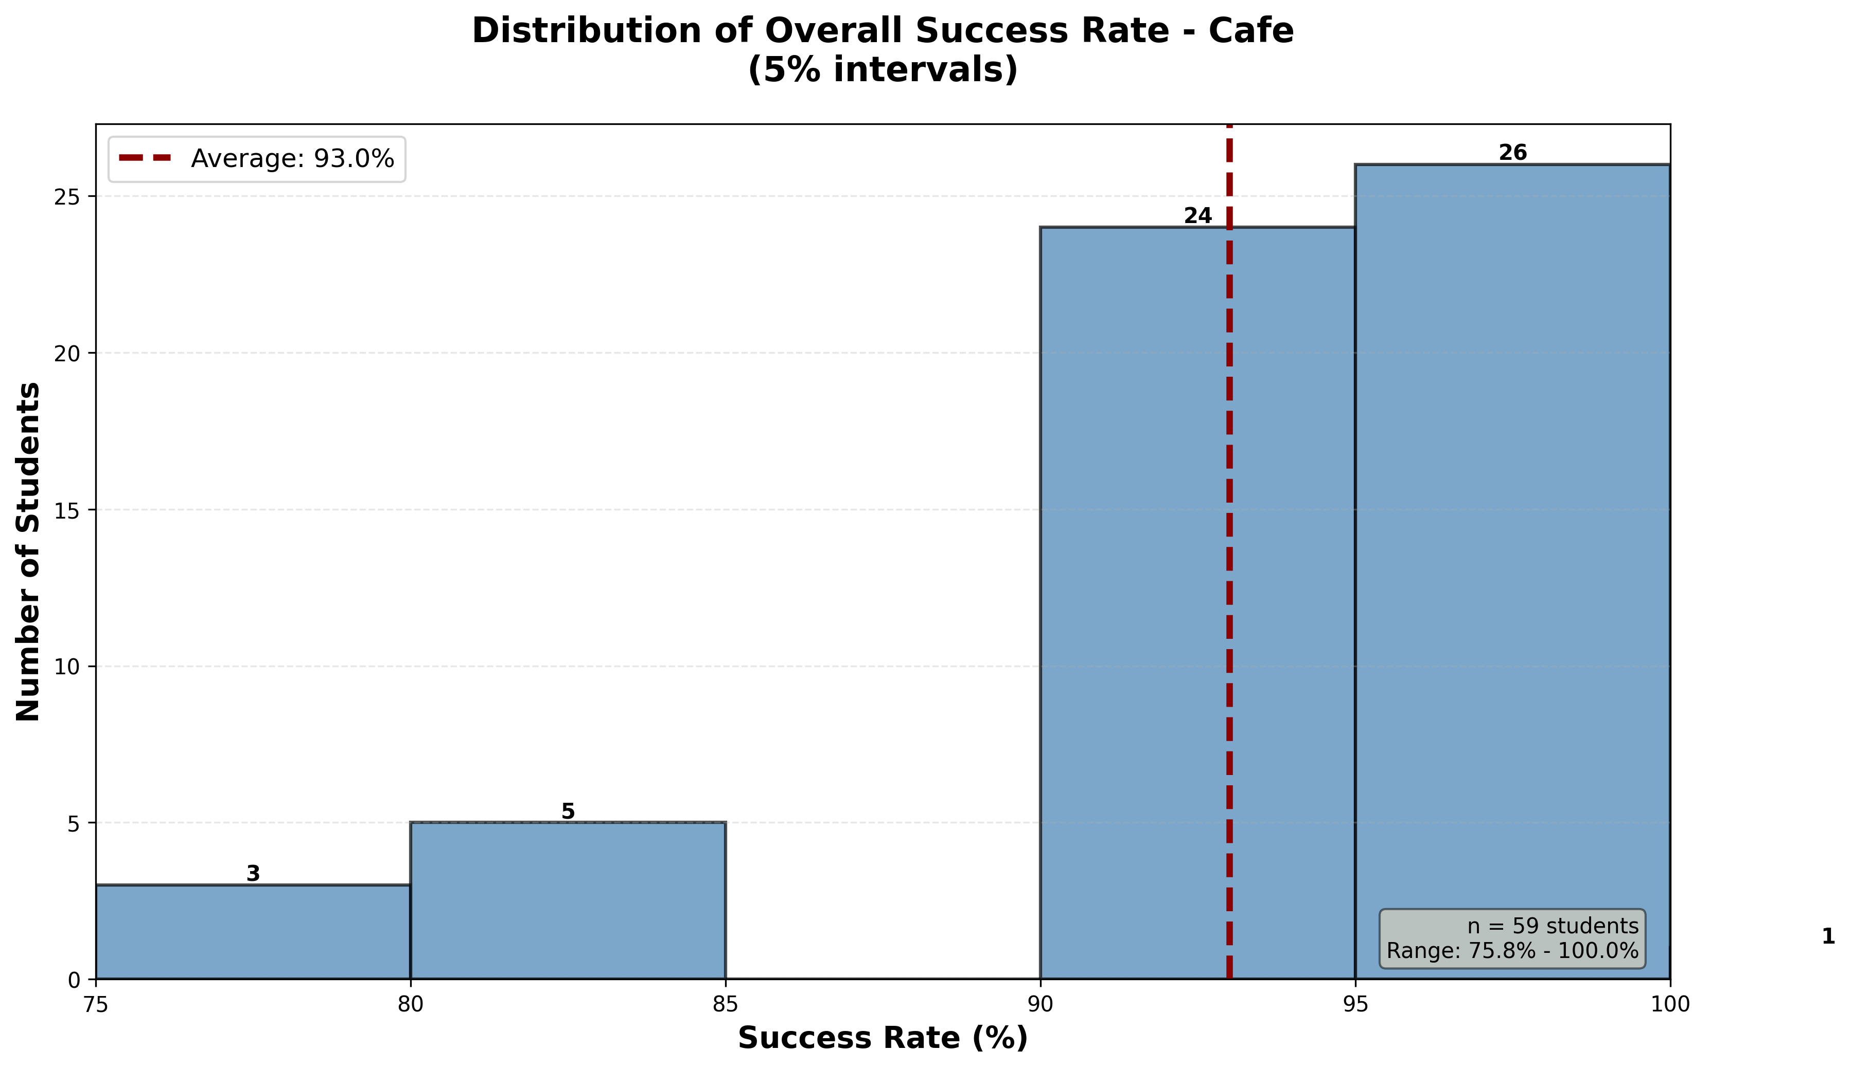

Slide 21
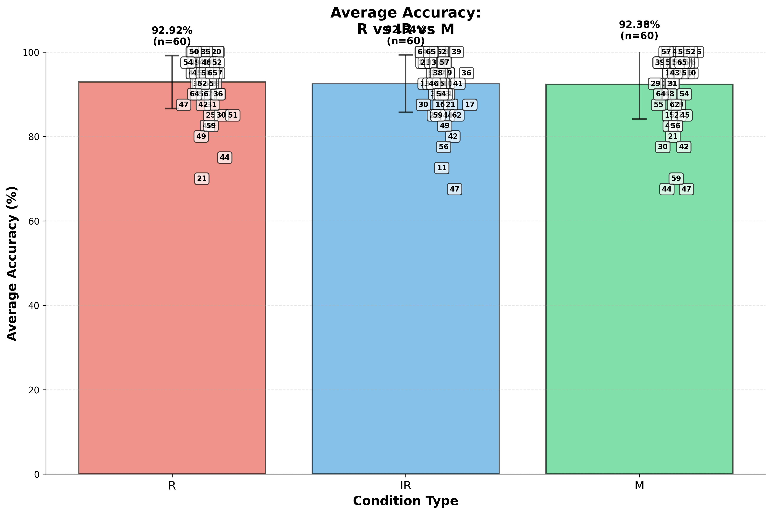

Slide 22
Anova- one way
Source of Variation | SS | df | F | P-value | F crit
Between Groups | 9.236111 | 2 | 0.090061 | 0.913917 | 3.047012
Within Groups | 9076.042 | 177

Slide 23
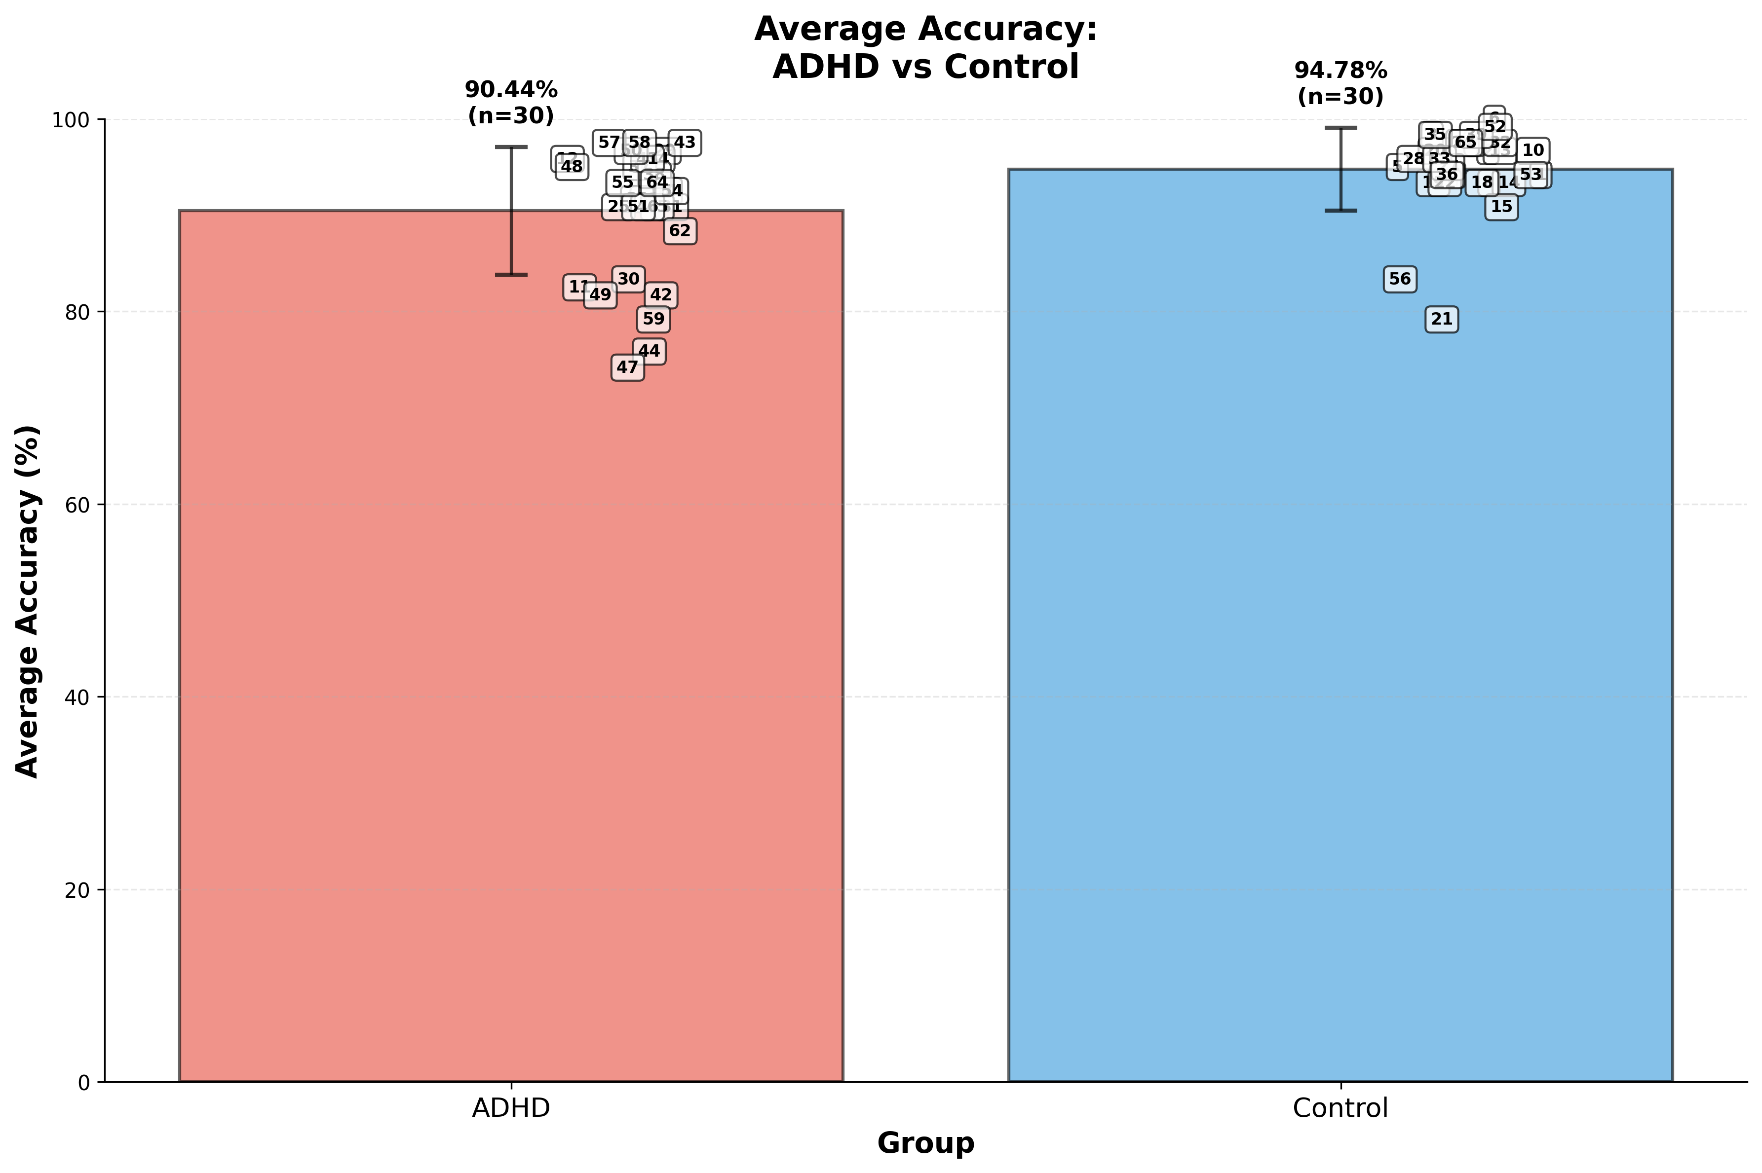

Slide 24
T-test independent- ADHD , Control
T-test results
t-statistic | -3.004
p-value | 0.0039
Degrees of Freedom (df) | 58
Effect size(Cohen's d)
Cohen's d Value | -0.7759

Slide 25
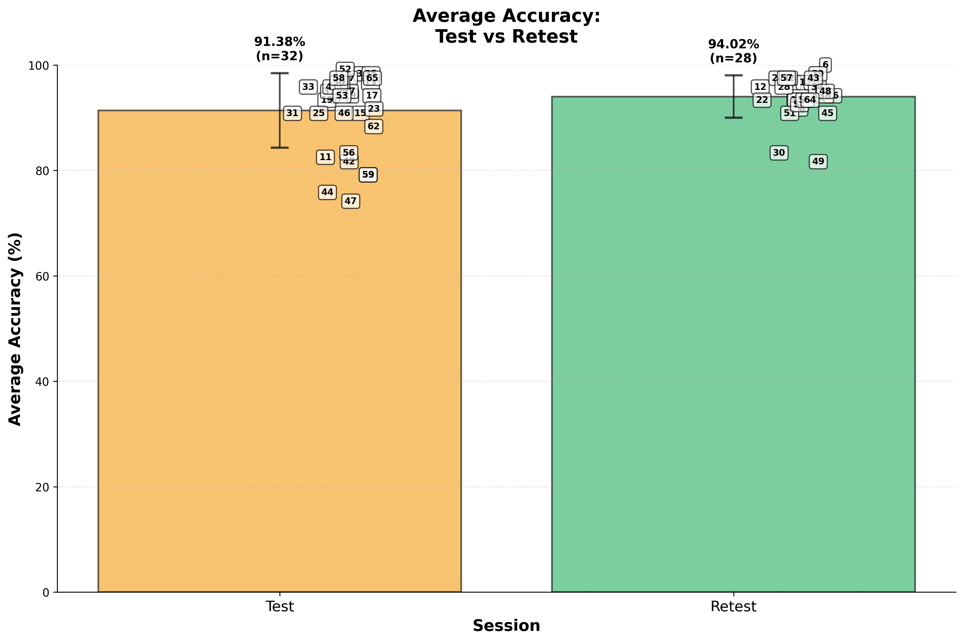

Slide 26
Café
-Interest level

Slide 27
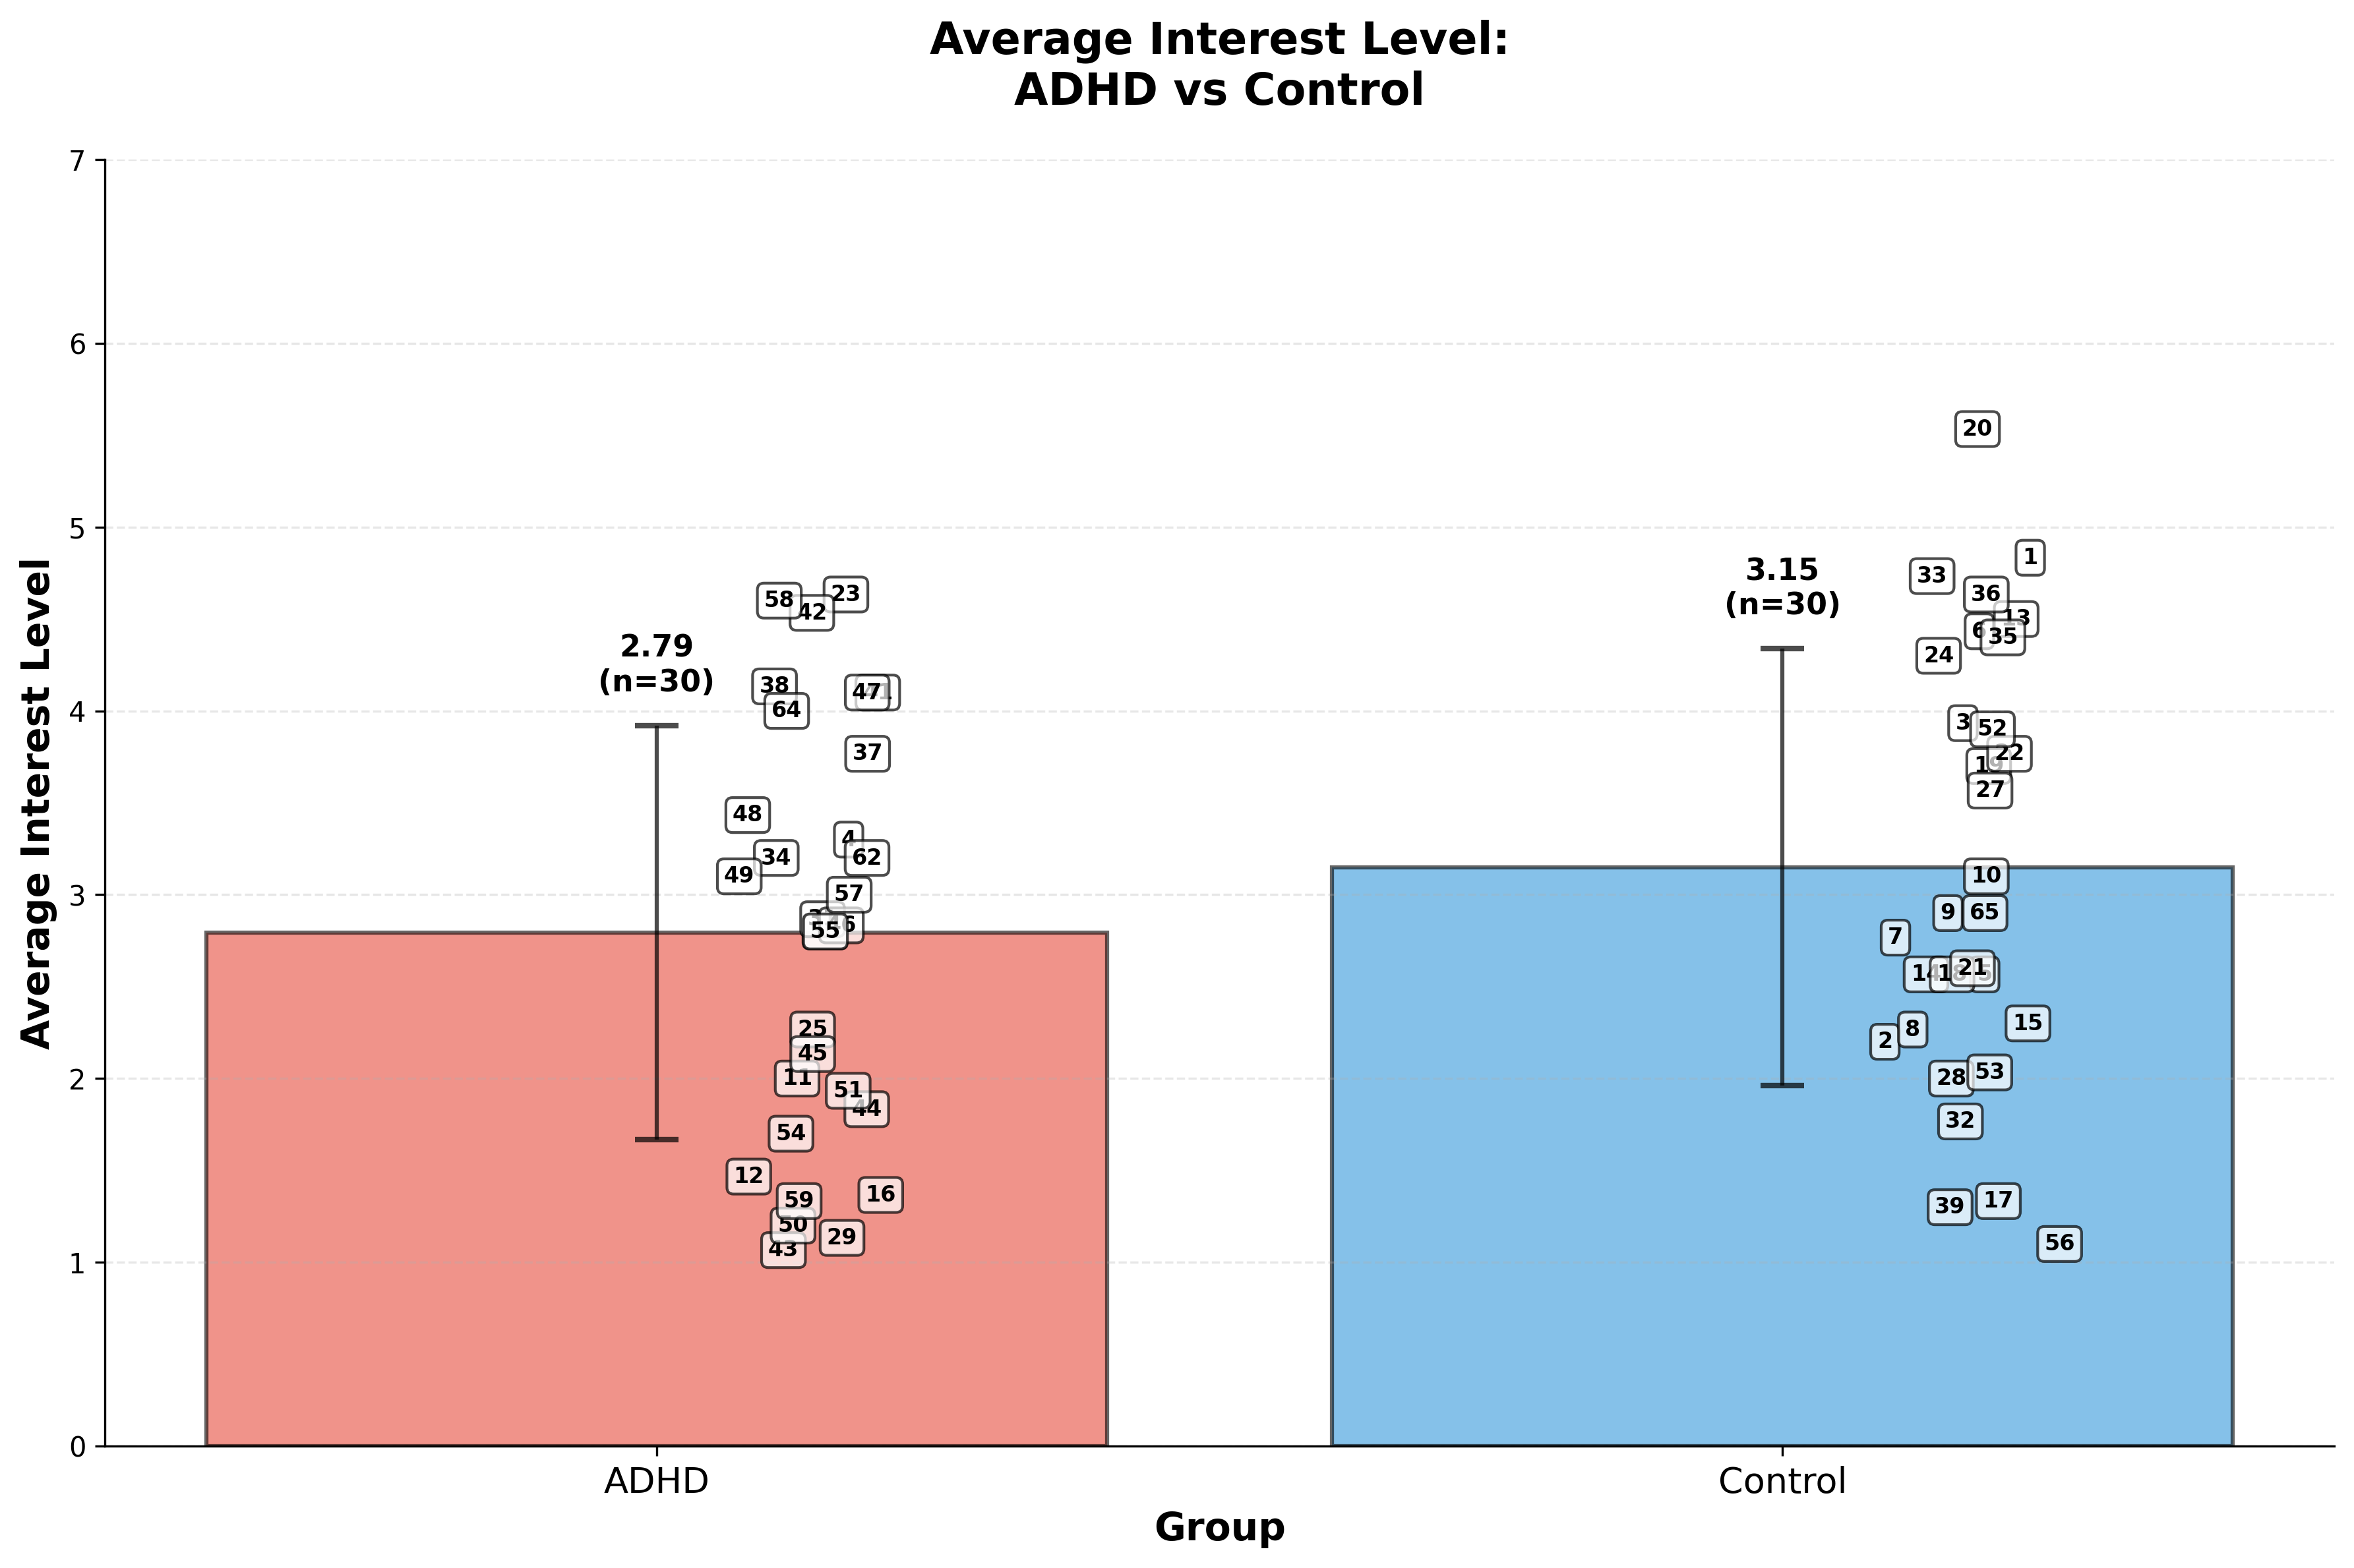

Slide 28
T-test independent- ADHD , Control
T-test results
t-statistic | -1.1886
p-value | 0.2394
Degrees of Freedom (df) | 58
Effect size(Cohen's d)
Cohen's d Value | -0.3069

Slide 29
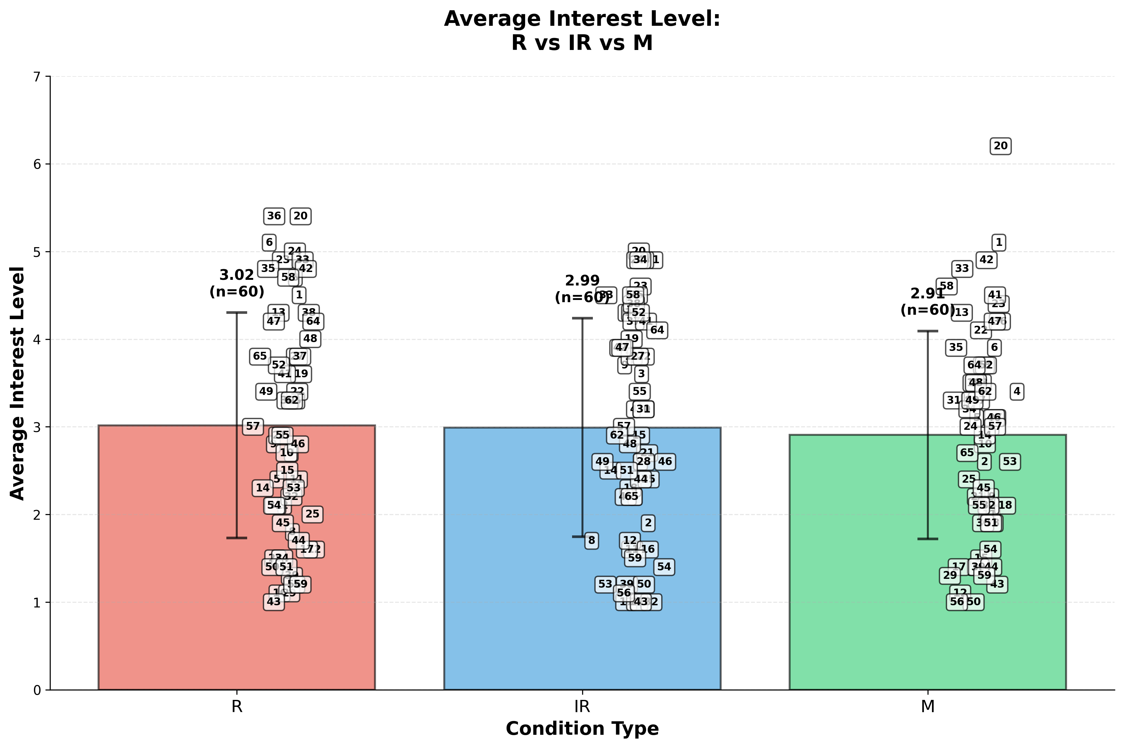

Slide 30
Anova- one way
Source of Variation | SS | df | F | P-value | F crit
Between Groups | 0.38611 | 2 | 0.12565 | 0.88200 | 3.04701
Within Groups | 271.955 | 177

Slide 31
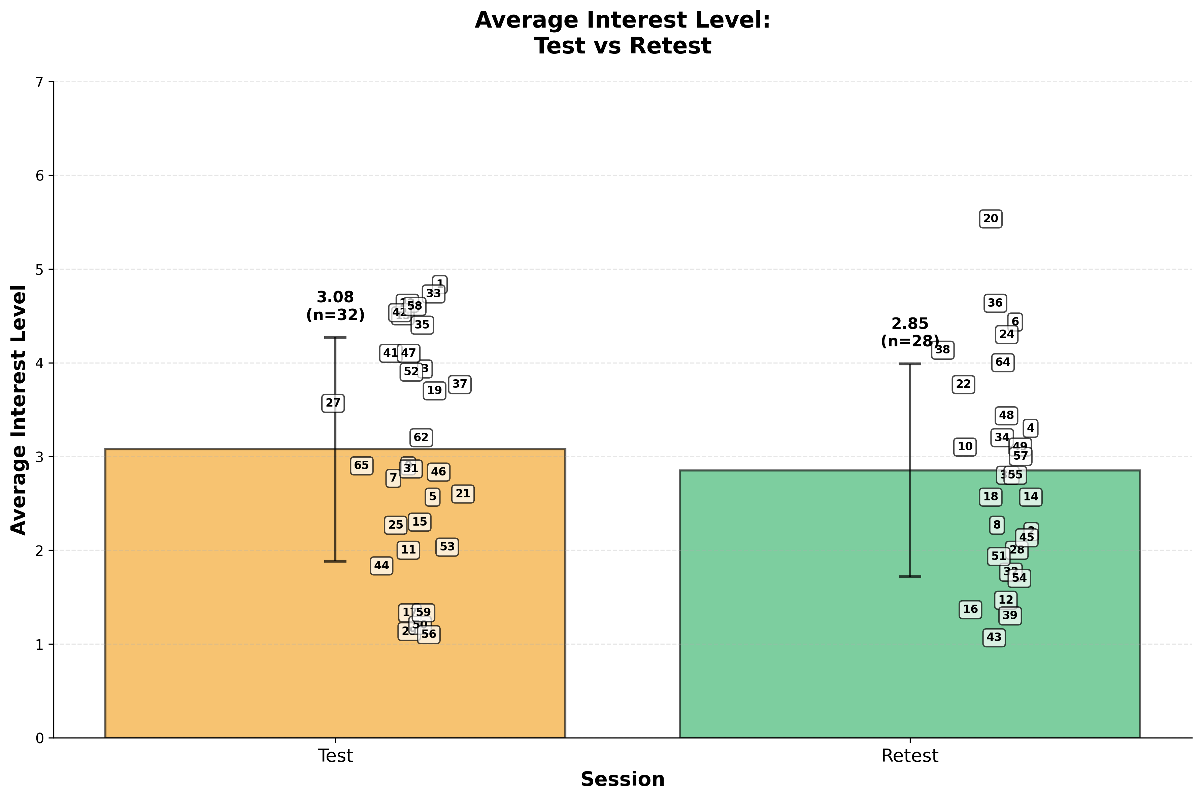

Slide 32

Cafe environment
Compare environments
מידע על הסביבה

Slide 33
Cafe environment
Accuracy [%]
מידע על הסביבה
category | Percentage
Mean different | 6.55%
Standard Deviation (SD) | 2.35%
Variance | 157.09%

Slide 34
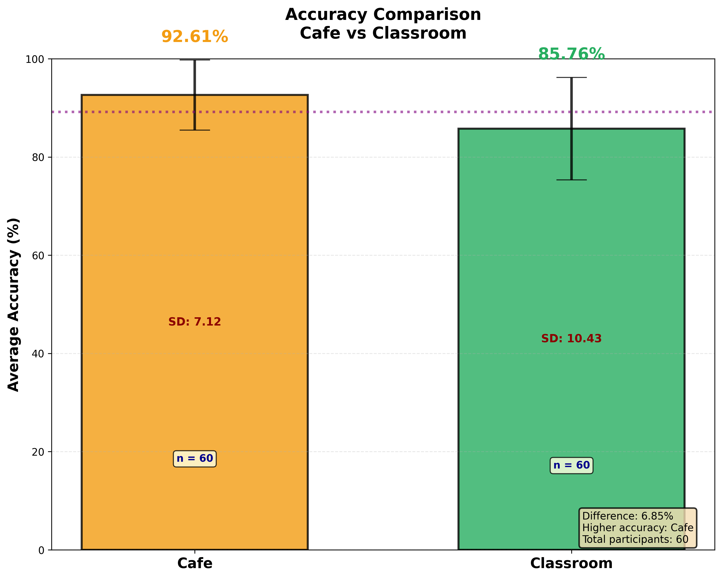

Slide 35
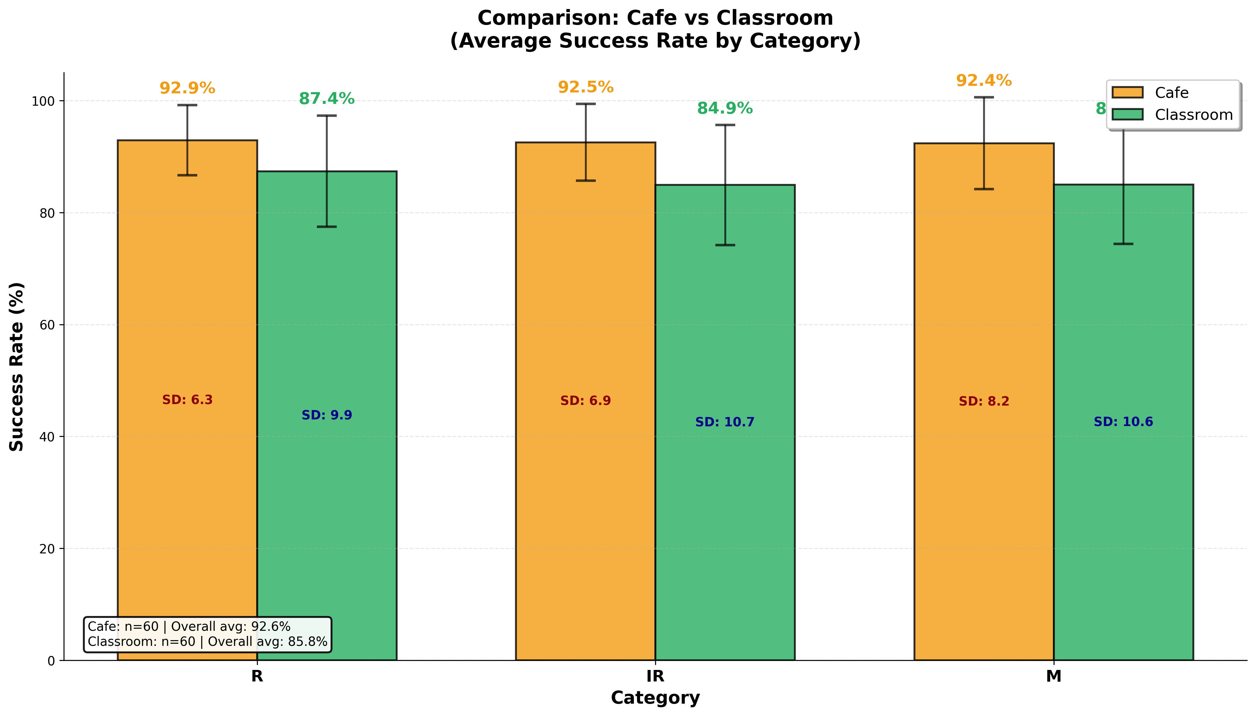

Slide 36
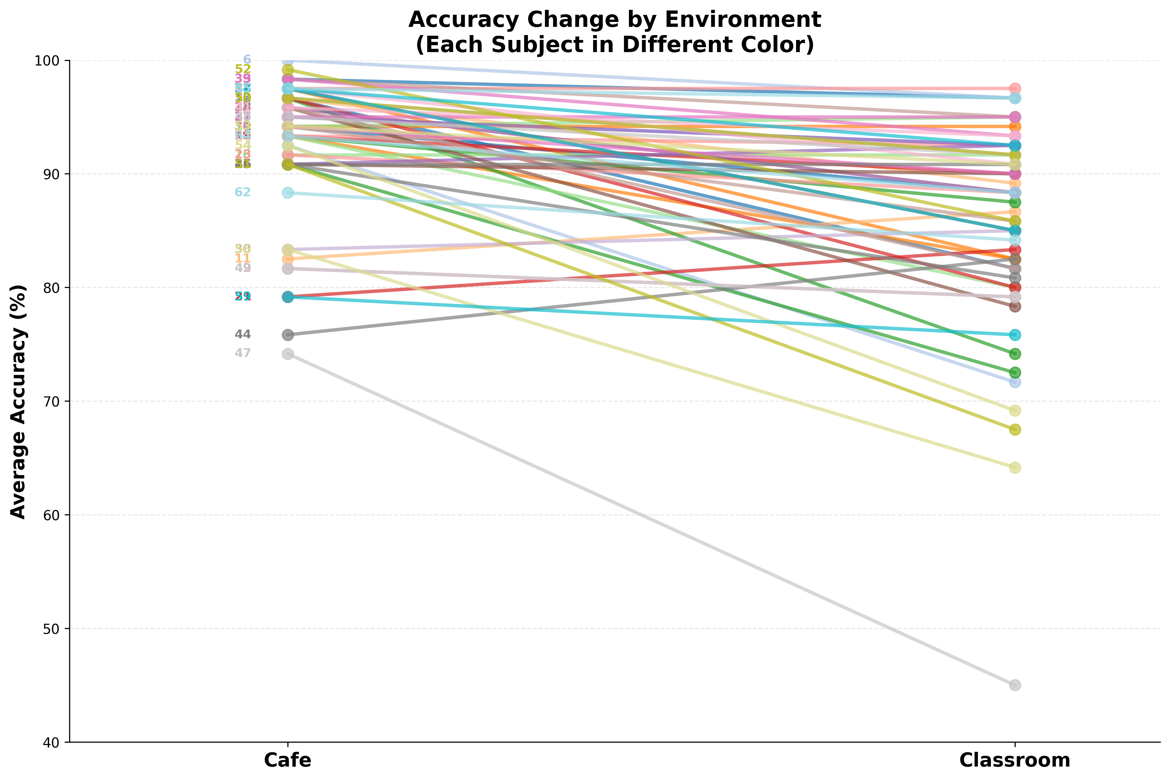

Slide 37
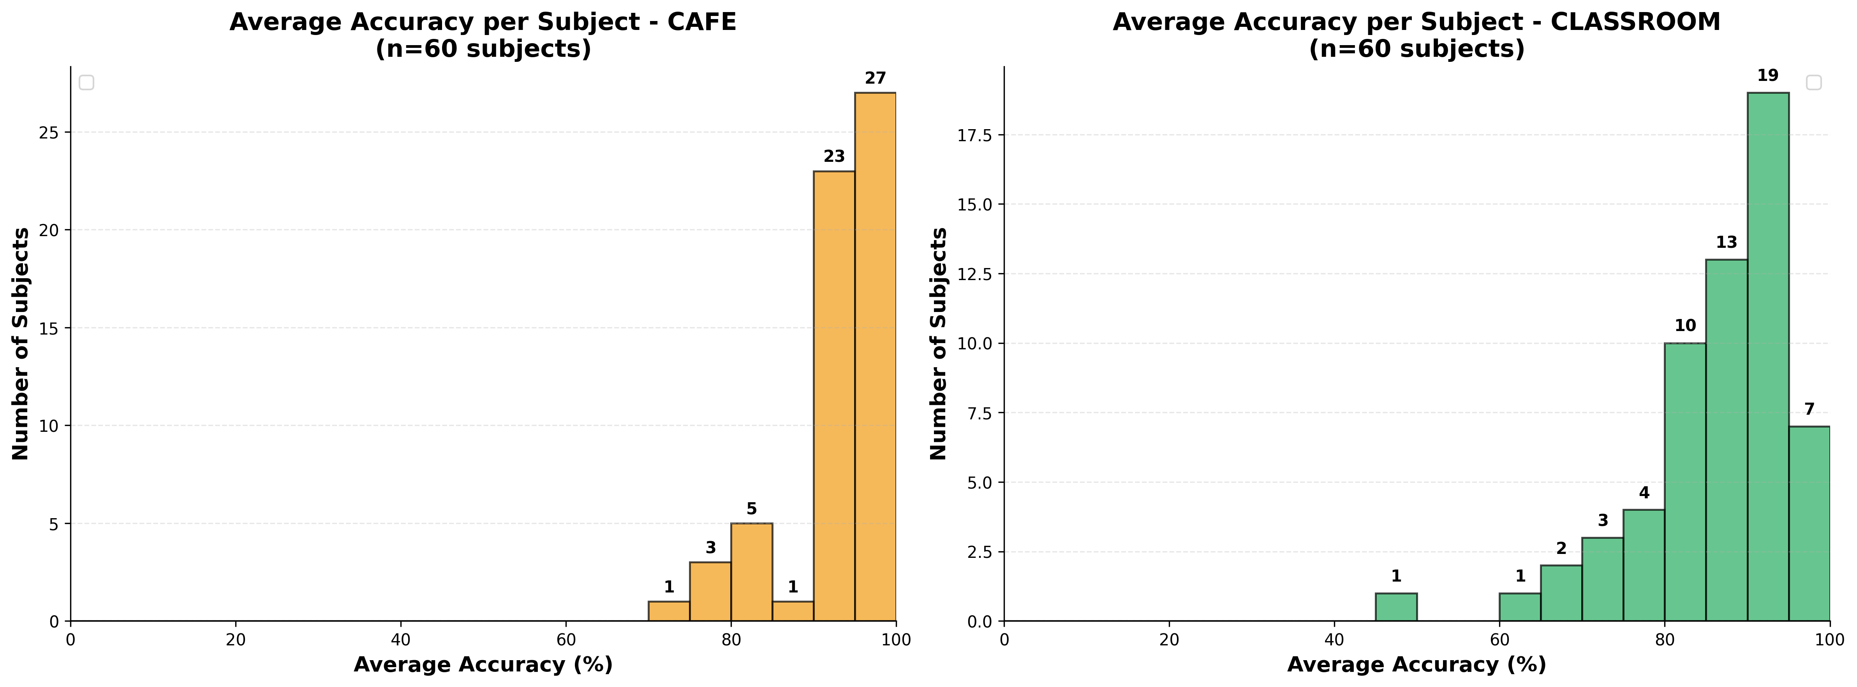

Slide 38
Cafe environment
t-Test: Paired Two Sample for Means
מידע על הסביבה
Category | result
t Stat | 6.72
P(T<=t) two-tail | 0.00000002
t Critical two-tail | 2.001

Slide 39
Cafe environment
Interest-level
מידע על הסביבה
category | Percentage
Mean different | 0.79%
Standard Deviation (SD) | 0.06%
Variance | 0.0015%

Slide 40
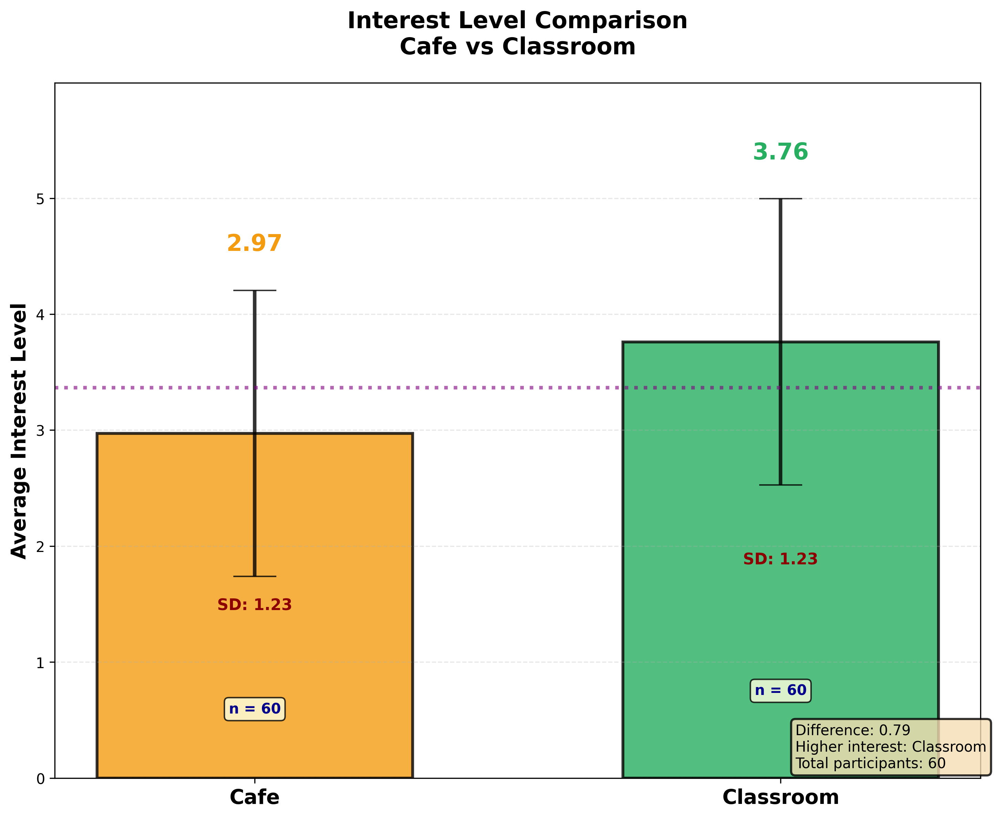

Slide 41
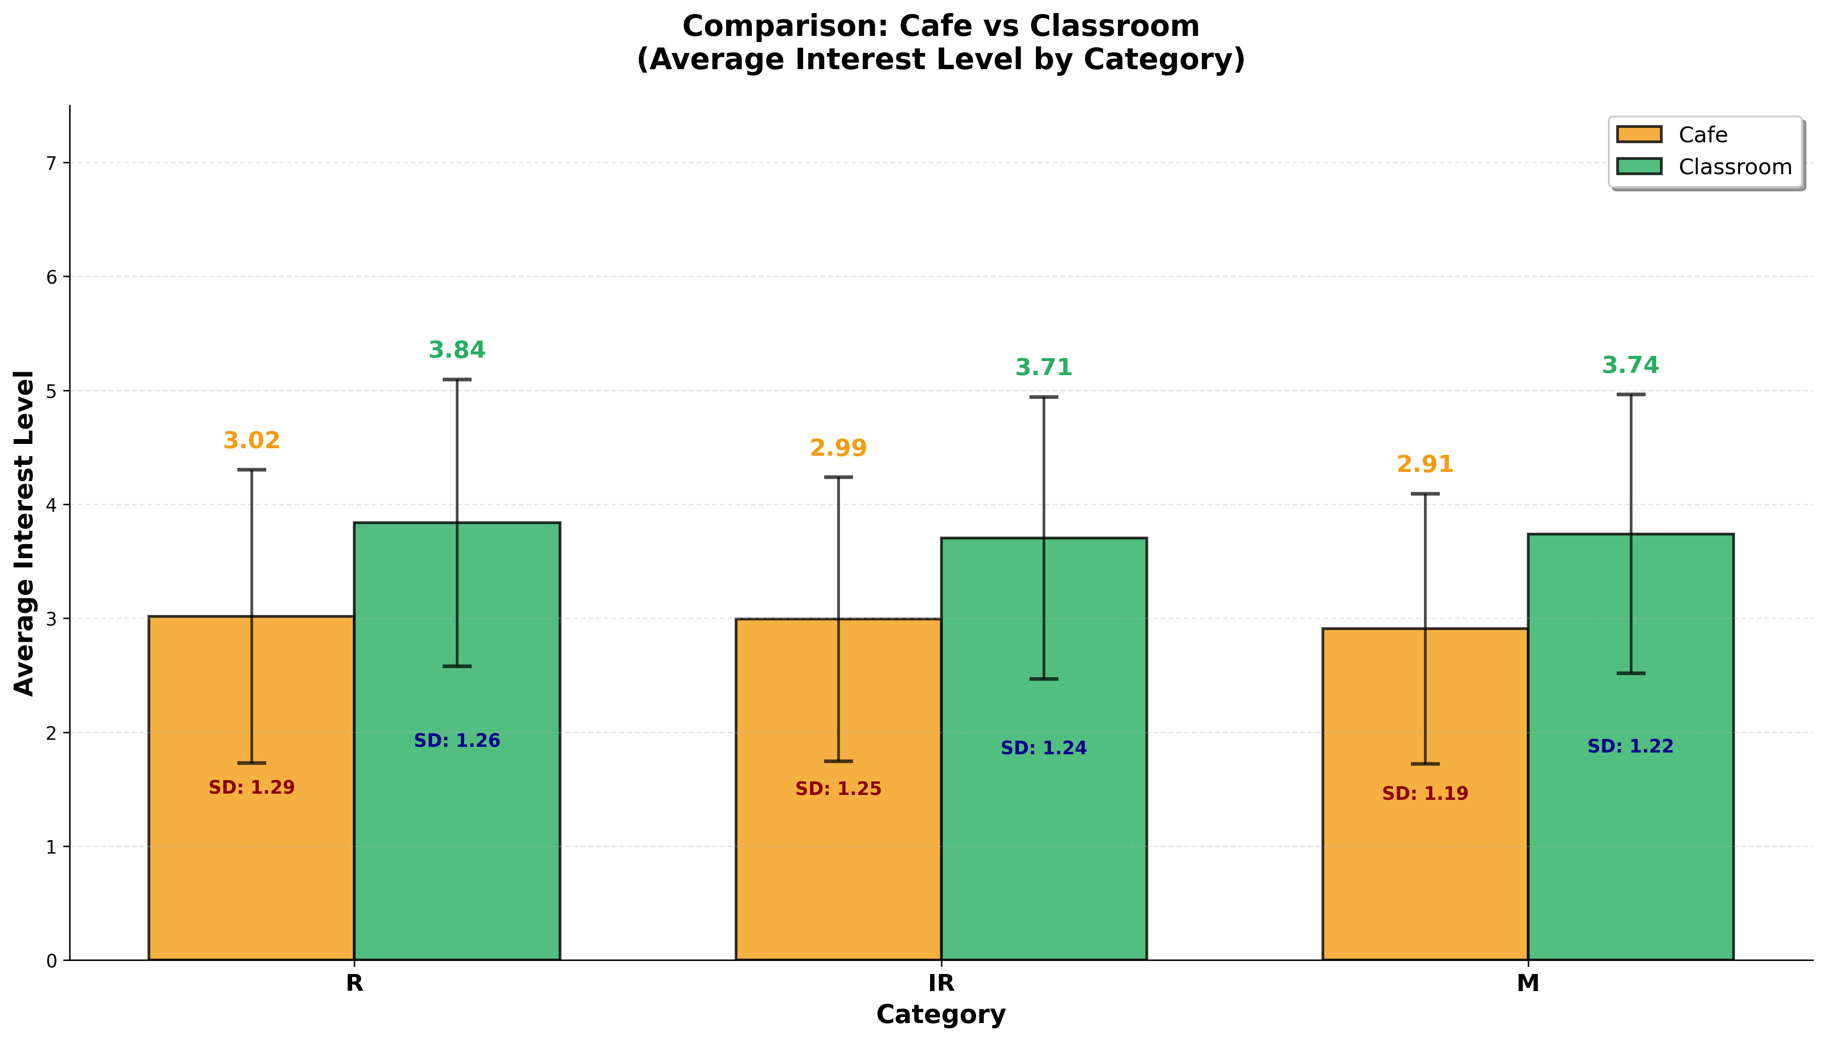

Slide 42
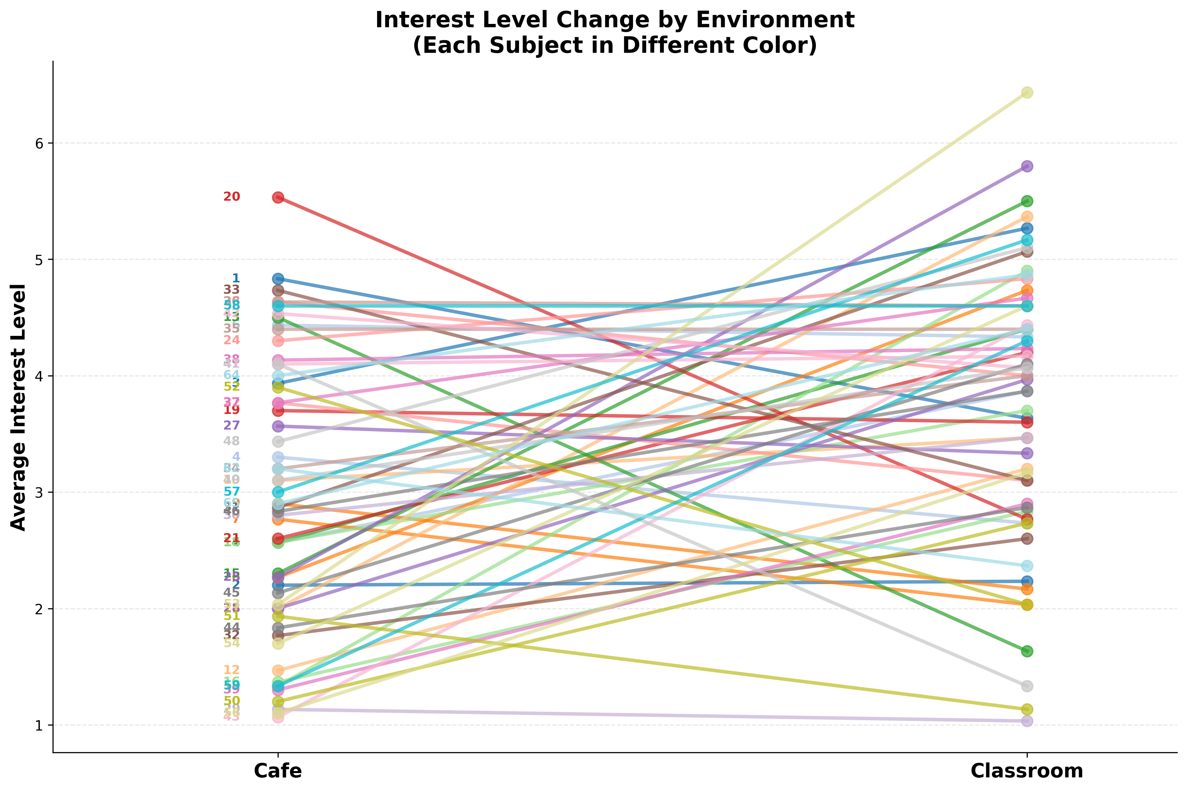

Slide 43
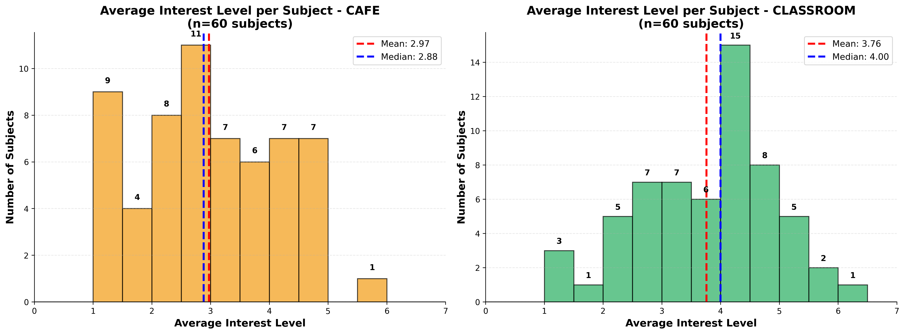

Slide 44
Cafe environment
t-Test: Paired Two Sample for Means
מידע על הסביבה
Category | result
t Stat | 3.717
P(T<=t) two-tail | 0.00045
t Critical two-tail | 2.001

Slide 45
Code for analysis
https://github.com/pelegaboz/first_Data_for_lub

